Slide 1
ENHANCING SUBWAY FLOOD MANAGEMENT USING IoT

Slide 2



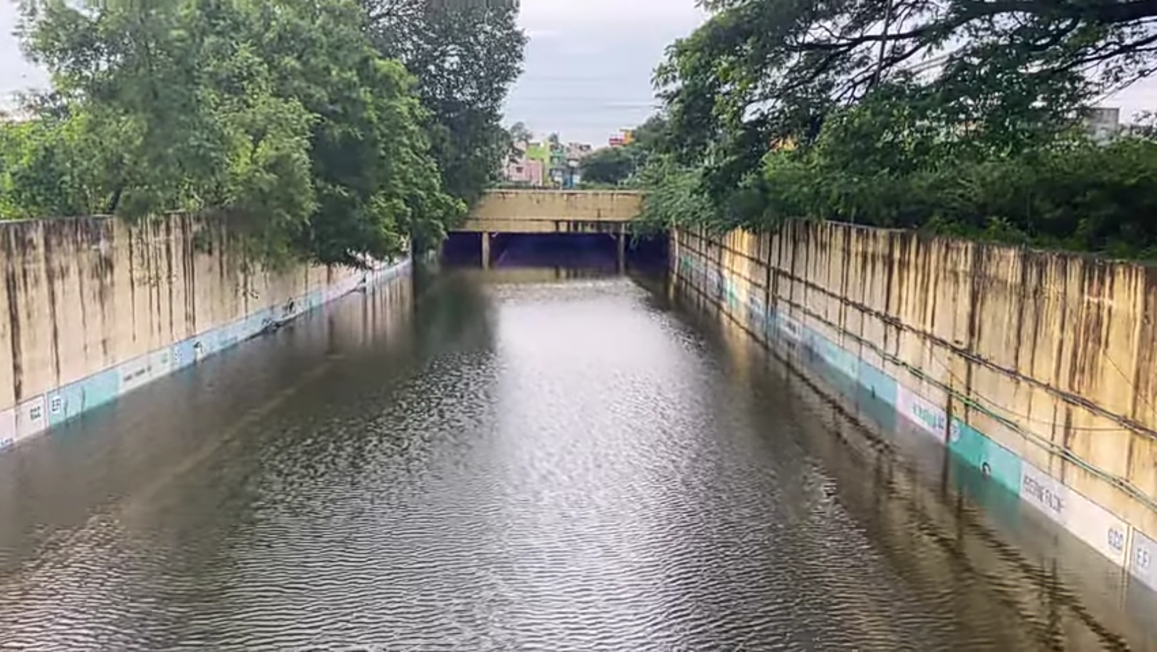



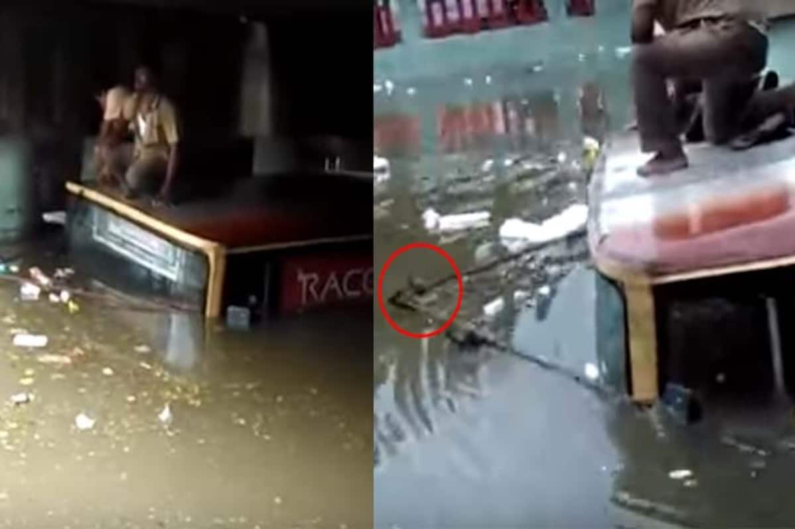

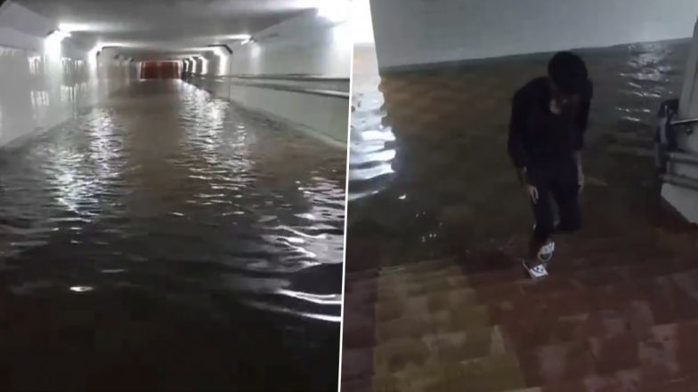
IDEA / APPROACH DETAILS
Challenges : Urban flooding, specifically inundation of subways during rainfall.
Significance : Subways at heightened risk.
Recently Chennai city received 468mm of rain between December 4 and 5 that led to massive flooding.17 out of 22 subways in the city was closed due to water logging and it took nearly one week to completely drain the flood water, where the automation lagged.
Villivakkam subway
Delayed evacuation
Prolonged subway closures
Pazhavanthangal subway
Compromised public safety

Slide 3
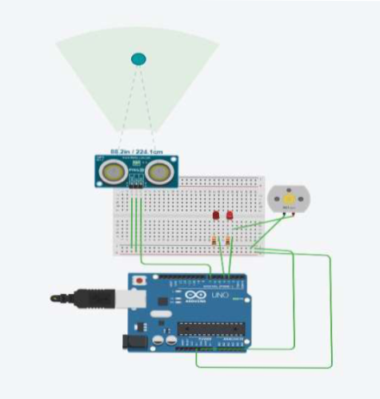
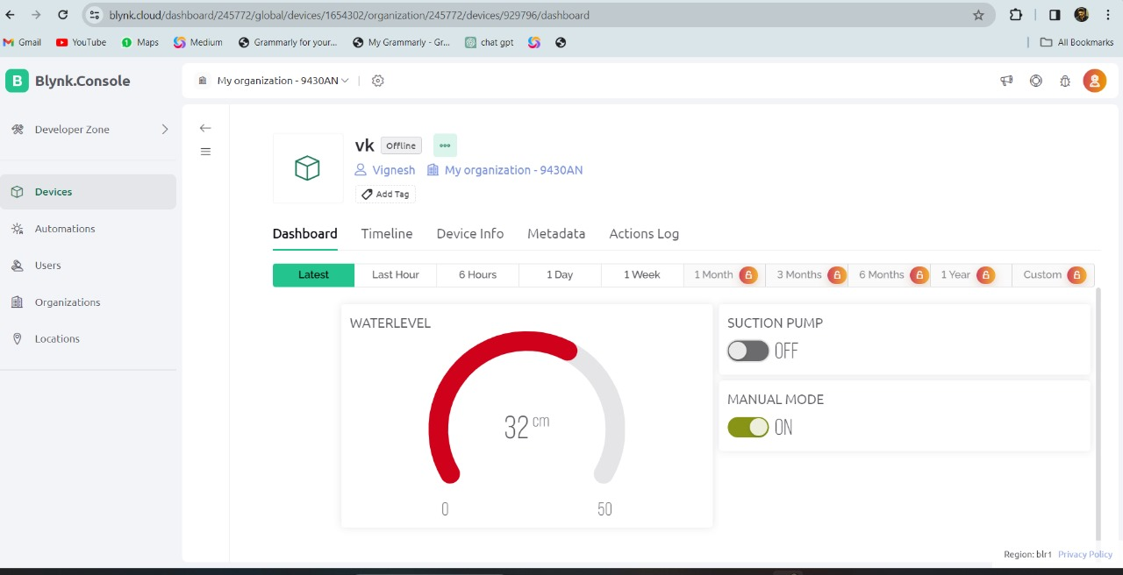
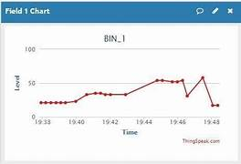
Idea/Approach Details
Our project strategically addresses urban subways flood management, employing IoT- enabled sensors for real time detection and automated control , powered by an Arduino based system , it ensures efficient water removal and seamless subway operations.
The incorporation of a centralized control room provides immediate alerts , reinforcing our commitment to safeguarding against potential disruptions.

Slide 4
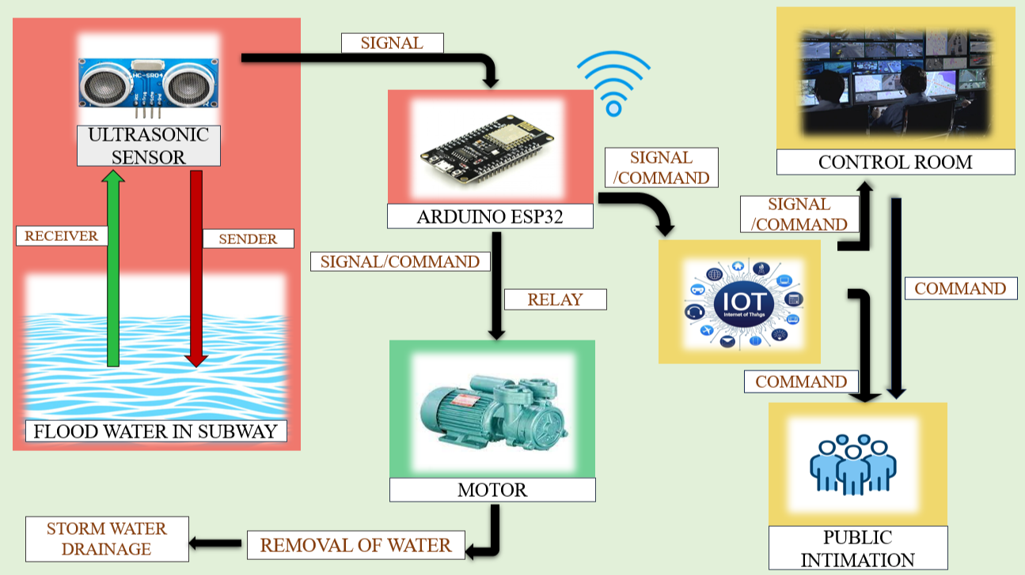
Block diagram of Proposed Idea

Slide 5

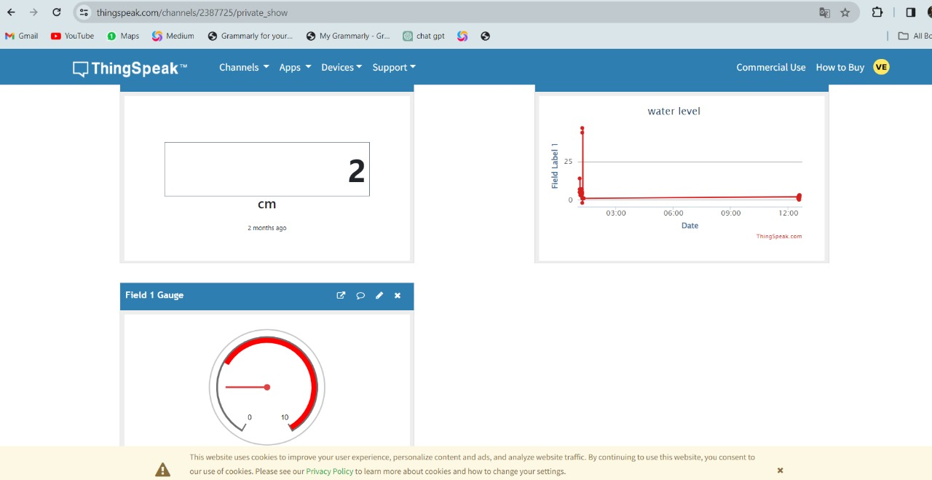

Proposed Technology
The primary part of the Iot is Blynk Iot platform, which consists of dashboard and other controls
Public Display (Things Speak): Provides real-time subway status on public-facing websites, enhancing public awareness of water levels and flood risks.
Control Room(Blynk) :Authorized monitoring and manual control of subway status via a user-friendly dashboard.
The status of subway can be monitored and controlled by the authorized person using Blynk (can also accessed in Mobile phones)

Slide 6

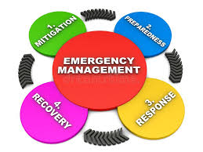

FEASABILITY AND SUSTAINABILITY
Proven Technology Stack: Established technologies (Arduino ESP32, Blynk) ensure technical viability.
Cost-Effectiveness:Uses affordable components for overall feasibility.
Scalability:Modular design for easy adaptation to different subway sizes.
User-Friendly Interface: Blynk's dashboard simplifies control and monitoring.
Resource Conservation:Efficient flood management minimizes water-related damages.
Energy Efficiency:Automated mechanisms optimize resource use and energy.
Public Awareness: ThingSpeak display fosters awareness for responsible water use.

Slide 7
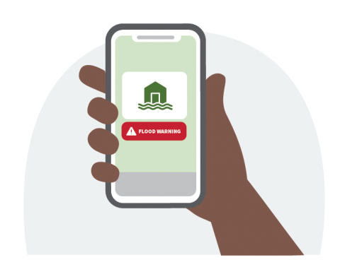


Scale of Impact
Positive Environmental Impacts:
Safeguards ecosystem from disruption caused by flooding
Reduces the need for emergency response during flood events
Social Impacts:
Protects public from immediate dangers of flooding
Mitigates financial losses due to subway closures and infrastructure damage
Minimizes health risks linked to flooding like water borne diseases
Notes:
Scale of impact:

Slide 8
INDIRECT IMPACTS

Slide 9
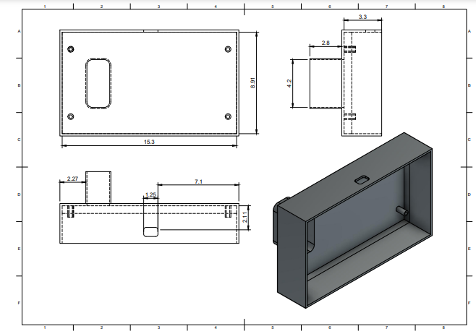
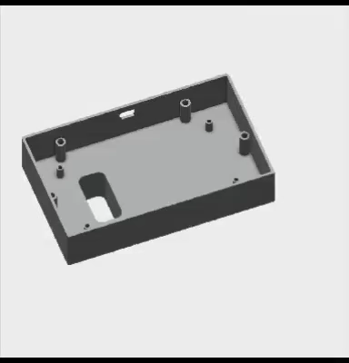
Future Scope
Refining and Optimization of Prototype: - Focus on refining and optimizing the flood management system prototype for improved functionality.
Align with Smart City Frameworks:- Ensure the system aligns with broader smart city frameworks for holistic urban infrastructure management.

Slide 10
Lean Canvas
Problem The accumulated floodwater In the subway road transport system due to heavy rain and overflow of rivers and lakes in the surroundings causing trouble that makes transportation difficult. | Solution Removing the flood water inside the subways automatically at the time of heavy rains or flood and all time surveillance of all subway from a single control room using IoT. | Unique Value Proposition The automation and the ability to control a mass number of subways from a single control room anytime from anywhere using mobile applications makes our idea to stand unique. |  | Unfair Advantage IoT integration expertise Proprietary flood detection algorithm | Customer Segments Urban authorities Emergency services Infrastructure developers Collaborate with IoT provider for seamless communication. Collaborate with pilot cities for trials.
Existing Alternatives The manual pumping out of water from the inundated subway is practised at present which lags in timely intervention causing prolonged closures of subways. | Key Metrics Data accuracy Automation Timely intervention Real time monitoring |  |  | Channels Collaborative projects Partnerships and alliances
Cost Structure Software licences Prototyping materials Manufacturing materials Assembly and production Marketing and promotion |  |  | Revenue Structure Project funding Collaborations and competitions Workshops and training sessions

Slide 11
THANK YOU

